Slide 1


Department of Computer Science
University Institute of Engineering
DEPARTMENT OF COMPUTER SCIENCE & ENGINEERING
Bachelor of Engineering
Subject Name: System Programming
Subject Code: CST-281
Compilers
DISCOVER . LEARN . EMPOWER

Slide 2
Chapter-2.1 Compilers
Department of computer Science
Case Study :LEX
Yacc

Slide 3
LEX
Lex is officially known as a "Lexical Analyser".
It's main job is to break up an input stream into more usable elements.
Or in, other words, to identify the "interesting bits" in a text file.

Slide 4
LEX
For example, if you are writing a compiler for the C programming language, the symbols { } ( ); all have significance on their own.
The letter a usually appears as part of a keyword or variable name, and is not interesting on it's own.
Instead, we are interested in the whole word. Spaces and newlines are completely uninteresting, and we want to ignore them completely, unless they appear within quotes "like this"

Slide 5
LEX
All of these things are handled by the Lexical Analyser.
During the first phase the compiler reads the input and converts strings in the source to tokens.
With regular expressions we can specify patterns to lex so it can generate code that will allow it to scan and match strings in the input.

Slide 6
LEX
Each pattern specified in the input to lex has an associated action.
Typically an action returns a token that represents the matched string for subsequent use by the parser.
Initially we will simply print the matched string rather than return a token value.

Slide 7
LEX
The following represents a simple pattern, composed of a regular expression, that scans for identifiers.
Lex will read this pattern and produce C code for a lexical analyzer that scans for identifiers.
letter(letter|digit)*
This pattern matches a string of characters that begins with a single letter followed by zero or more letters or digits.

Slide 8
LEX
This example nicely illustrates operations allowed in regular expressions:
repetition, expressed by the “*” operator
alternation, expressed by the “|” operator
concatenation

Slide 9
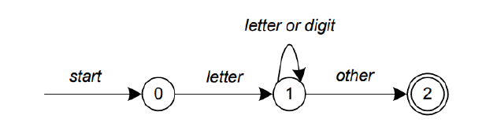
LEX
Any regular expression expressions may be expressed as a finite state automaton (FSA).
We can represent an FSA using states, and transitions between states. There is one start state and one or more final or accepting states.

Slide 10
LEX
In above Figure state 0 is the start state and state 2 is the accepting state.
As characters are read we make a transition from one state to another.
When the first letter is read we transition to state 1.
We remain in state 1 as more letters or digits are read.
When we read a character other than a letter or digit we transition to accepting state 2.
Any FSA may be expressed as a computer program.

Slide 11
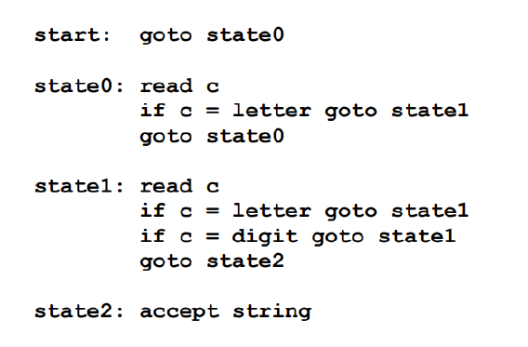
LEX
For example, our 3-state machine is easily programmed:

Slide 12
LEX
This is the technique used by lex.
Regular expressions are translated by lex to a computer program that mimics an FSA.
Using the next input character and current state the next state is easily determined by indexing into a computer-generated state table.

Slide 13
LEX
LEX’s limitations
lex cannot be used to recognize nested structures such as parentheses.
Nested structures are handled by incorporating a stack.
Whenever we encounter a “(” we push it on the stack. When a “)” is encountered we match it with the top of the stack and pop the stack

Slide 14
LEX
However lex only has states and transitions between states.
Since it has no stack it is not well suited for parsing nested structures.
Yacc augments an FSA with a stack and can process constructs such as parentheses with ease.
The important thing is to use the right tool for the job.
Lex is good at pattern matching.
Yacc is appropriate for more challenging tasks.

Slide 15
YACC
Yacc is officially known as a "parser".
It's job is to analyse the structure of the input stream, and operate of the "big picture".
In the course of it's normal work, the parser also verifies that the input is syntactically sound.

Slide 16
YACC
Consider again the example of a C-compiler. In the C-language, a word can be a function name or a variable, depending on whether it is followed by a ( or a = There should be exactly one ) for each in the program. YACC stands for "Yet Another Compiler".
This is because this kind of analysis of text files is normally associated with writing compilers.

Slide 17
YACC
For example, a C program may contain something like:
{
int i;
i= 33;
printf("int: %d\n",i);
}

Slide 18
YACC
In this case, the lexical analyzer would have broken the input stream into a series of "tokens", like this:
{
int
i
;
i
=
33

Slide 19
YACC
;
printf
(
"int: %d\n"
,
i
)
;
}

Slide 20
YACC
The lexical analyser has already determined that where the keyword int appears within quotes, it is really just part of a literal string.
It is up to the parser to decide if the token int is being used as a keyword or variable.
The parser also ensures that each statement ends with a ; and that the brackets balance.

Slide 21
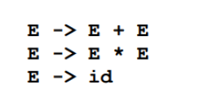
YACC
Grammars for yacc are described using a variant of Backus Naur Form (BNF).
This technique, pioneered by John Backus and Peter Naur, was used to describe ALGOL60.
A BNF grammar can be used to express context-free languages. Most constructs in modern programming languages can be represented in BNF.
For example, the grammar for an expression that multiplies and adds numbers is

Slide 22
YACC
Three productions have been specified.
Terms that appear on the left-hand side (lhs) of a production, such as E (expression) are non-terminals.
Terms such as id (identifier) are terminals (tokens returned by lex) and only appear on the right-hand side (rhs) of a production.
This grammar specifies that an expression may be the sum of two expressions, the product of two expressions, or an identifier.

Slide 23
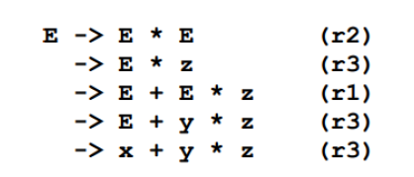
YACC
We can use this grammar to generate expressions:

Slide 24
YACC
At each step we expanded a term and replace the lhs of a production with the corresponding rhs.
The numbers on the right indicate which rule applied.
To parse an expression we need to do the reverse operation. Instead of starting with a single non-terminal (start symbol) and generating an expression from a grammar we need to reduce an expression to a single non-terminal.
This is known as bottom-up or shift-reduce parsing and uses a stack for storing terms.

Slide 25
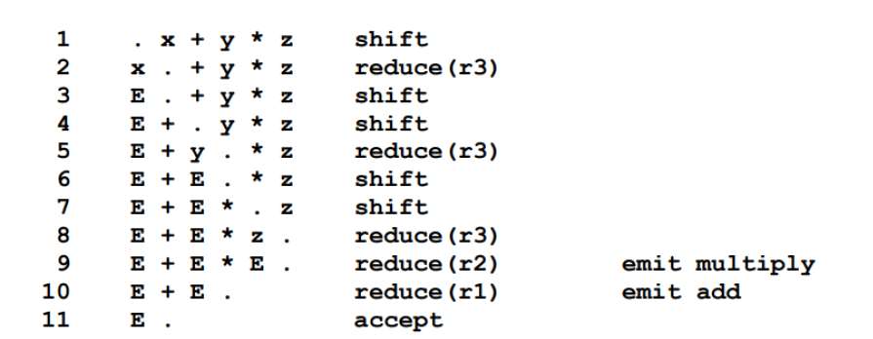
YACC

Slide 26
YACC
Terms to the left of the dot are on the stack while remaining input is to the right of the dot.
We start by shifting tokens onto the stack. When the top of the stack matches the rhs of a production we replace the matched tokens on the stack with the lhs of the production.
In other words the matched tokens of the rhs are popped off the stack, and the lhs of the production is pushed on the stack.
The matched tokens are known as a handle and we are reducing the handle to the lhs of the production.

Slide 27
YACC
This process continues until we have shifted all input to the stack and only the starting non-terminal remains on the stack.
In step 1 we shift the x to the stack. Step 2 applies rule r3 to the stack to change x to E.
We continue shifting and reducing until a single non-terminal, the start symbol, remains in the stack. In step 9, when we reduce rule r2, we emit the multiply instruction.
Similarly the add instruction is emitted in step 10. Consequently multiply has a higher precedence than addition.

Slide 28
YACC
Consider the shift at step 6.
Instead of shifting we could have reduced and apply rule r1. This would result in addition having a higher precedence than multiplication.
This is known as a shift reduce conflict.
Our grammar is ambiguous because there is more than one possible derivation that will yield the expression.
In this case operator precedence is affected. As another example, associativity in the rule:
E -> E + E is ambiguous, for we may recurse on the left or the right.

Slide 29
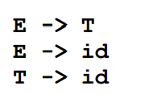
YACC
To remedy the situation, we could rewrite the grammar or supply yacc with directives that indicate which operator has precedence.
The following grammar has a reduce-reduce conflict. With an id on the stack we may reduce to T, or E.

Slide 30
YACC
YACC takes a default action when there is a conflict.
For shift-reduce conflicts yacc will shift.
For reduce-reduce conflicts it will use the first rule in the listing.
It also issues a warning message whenever a conflict exists.
The warnings may be suppressed by making the grammar unambiguous.

Slide 31
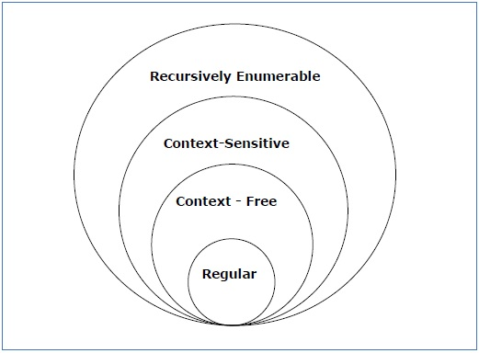
Types of Grammer
According to Noam Chomosky, there are four types of grammars − Type 0, Type 1, Type 2, and Type 3. The following table shows how they differ from each other −

Slide 32
Type - 3 Grammar
Type-3 grammars generate regular languages. Type-3 grammars must have a single non-terminal on the left-hand side and a right-hand side consisting of a single terminal or single terminal followed by a single non-terminal.
The productions must be in the form X → a or X → aY
where X, Y ∈ N (Non terminal)
and a ∈ T (Terminal)
The rule S → ε is allowed if S does not appear on the right side of any ru

Slide 33
Type - 2 Grammar
Type-2 grammars generate context-free languages.
The productions must be in the form A → γ
where A ∈ N (Non terminal)
and γ ∈ (T ∪ N)* (String of terminals and non-terminals).
These languages generated by these grammars are be recognized by a non-deterministic pushdown automaton.

Slide 34
Type - 1 Grammar
Type-1 grammars generate context-sensitive languages. The productions must be in the form
α A β → α γ β
where A ∈ N (Non-terminal)
and α, β, γ ∈ (T ∪ N)* (Strings of terminals and non-terminals)
The strings α and β may be empty, but γ must be non-empty.
The rule S → ε is allowed if S does not appear on the right side of any rule. The languages generated by these grammars are recognized by a linear bounded automaton.

Slide 35
Type - 0 Grammar
Type-0 grammars generate recursively enumerable languages. The productions have no restrictions. They are any phase structure grammar including all formal grammars
They generate the languages that are recognized by a Turing machine.
The productions can be in the form of α → β where α is a string of terminals and nonterminals with at least one non-terminal and α cannot be null. β is a string of terminals and non-terminals.
Example
S → ACaB
Bc → acB
CB → DB
aD → Db

Slide 36
References
Department of computer Science
https://www.javatpoint.com/yacc#:~:text=YACC%20stands%20for%20Yet%20Another,by%20LALR%20(1)%20grammar.
https://www.geeksforgeeks.org/introduction-to-yacc/
https://silcnitc.github.io/yacc.html

Slide 37
References
Department of computer Science
https://www.javatpoint.com/lex
https://www.academia.edu/2866013/LEX_a_case_study_in_development_and_validation_of_formal_specifications
https://www.epaperpress.com/lexandyacc/download/lex.pdf

Slide 38

THANK YOU

